Slide 1
Memory Management
Chapter 3

Slide 2
Memory
Paraphrase of Parkinson’s Law, ‘‘Programs expand to fill the memory available to hold them.’’
Average home computer nowadays has 10,000 times more memory than the IBM 7094, the largest computer in the world in the early 1960s

Slide 3
Cache Memory (Computer Arch.)
Principle of Locality
Memory Hierarchy Levels
Cache Memory
  Direct Mapped Cache
  Cache Misses, Write-Through and Write-Back
  Associative Caches
  Replacement Policy
  Multilevel Caches

Slide 4
Virtual Memory (Computer Arch.)
Virtual Memory
  Virtual and Physical Address
  Page Tables
  Address Translation Using a Page Table
  Page Fault Penalty
  Fast Translation Using a TLB

Slide 5
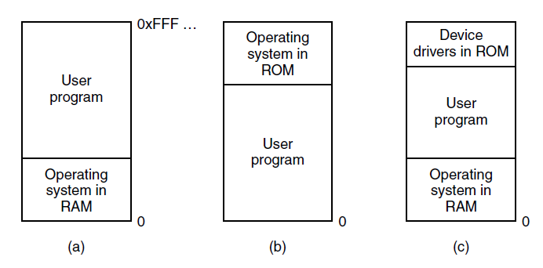
No Memory Abstraction
Figure 3-1. Three simple ways of organizing memory with an operating system and one user process. Other possibilities also exist

Slide 6
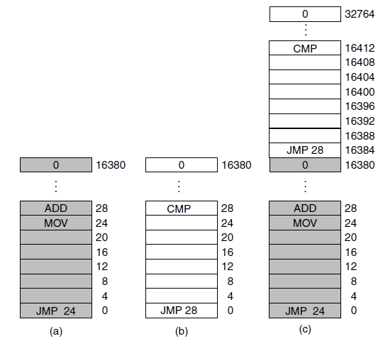
Running Multiple Programs Without a Memory Abstraction
Figure 3-2. Illustration of the relocation problem. (a) A 16-KB program. (b) Another 16-KB program. (c) The two programs loaded consecutively into memory.

Slide 7
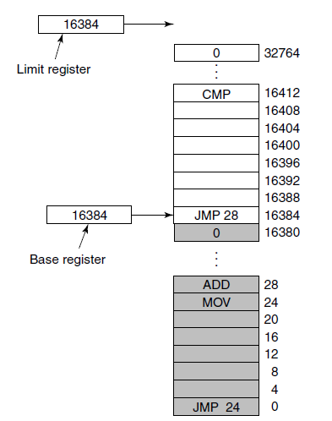
Base and Limit Registers
Figure 3-3. Base and limit registers can be used to give each process a separate address space.

Slide 8
Large Memory Footprint
Previous schemes require the physical memory of the computer is large enough to hold all the processes
Keeping all processes in memory all the time requires a huge amount of memory
Solution
  Swapping (process entirely in memory )
  Virtual Memory (process partially in memory)

Slide 9
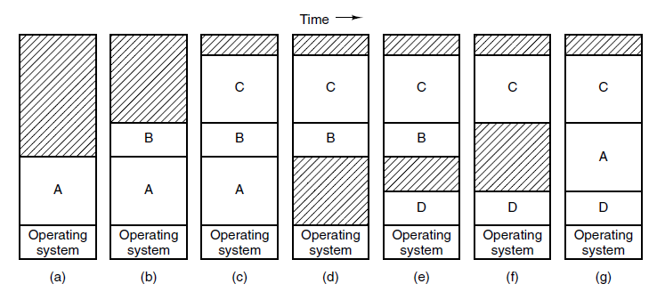
Swapping (1)
Figure 3-4. Memory allocation changes as processes come into memory and leave it. The shaded regions are unused memory

Slide 10
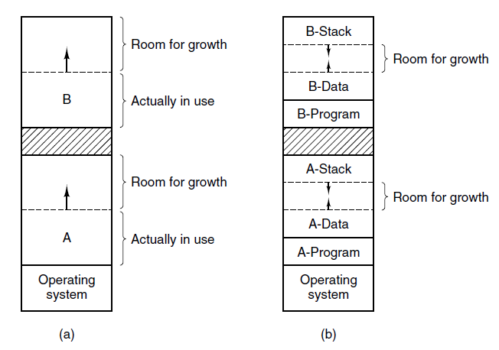
Swapping (2)
Figure 3-5. (a) Allocating space for a growing data segment.
(b) Allocating space for a growing stack and a growing data segment.

Slide 11
Swapping Issues
Memory compaction might be needed when swapping creates multiple holes In memory
If the growing process is adjacent to a hole
  it can be allowed to grow into the hole
If the growing process is adjacent to a process
  it has to be moved to a hole large enough for it
  or one or more processes have to be swapped out to create a large enough hole
  If both fail, the growing process will be suspended

Slide 12
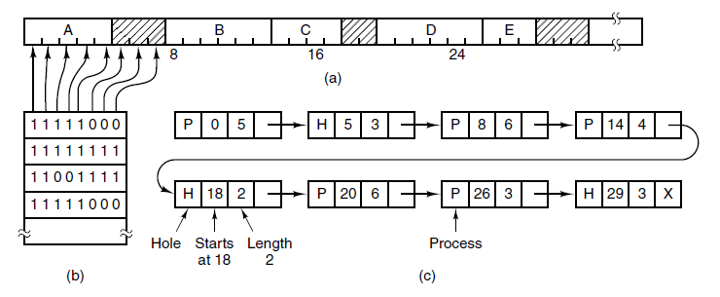
Memory Management with Bitmaps
Figure 3-6. (a) A part of memory with five processes and three holes. The tick marks show the memory allocation units. The shaded regions (0 in the bitmap) are free. (b) The corresponding bitmap. (c) The same information as a list.

Slide 13
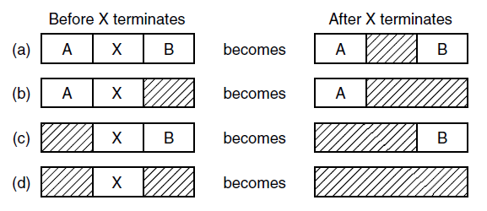
Memory Management with Linked Lists
Figure 3-7. Four neighbor combinations for the
terminating process, X. (double-linked list more convenient)

Slide 14
Memory Management Algorithms
First fit
Next fit
Best fit
Worst fit
Quick fit

Slide 15
Memory Management Algorithms
First fit
  Scans along the list of segments until it finds a hole that is big enough
  Fast because it searches as little as possible
Next fit
  Same as first fit, except it keeps tracks of where it is whenever it finds a suitable hole
  Next search start from where it left off last time
  Slightly worse than first fit [Bays, 1977]

Slide 16
Memory Management Algorithms
Best fit
  Searches the entire list and takes the smallest hole that is adequate
  Slower than first fit because of searching entire list
  More wasted memory due to tiny, useless holes
Worst fit
  Searches the entire list and takes the largest available hole
  Not a very good idea

Slide 17
Memory Management Algorithms
Maintaining separate lists for processes and holes can speed up all four algorithms
  Hole list may be kept sorted on size
Quick fit
  Maintains separate lists for some of the more common size requested (4KB, 8KB, 12KB etc.)
  Finding a hole of the required size is very fast
  When a process terminates or swapped out, finding neighbors for merge is quite expensive

Slide 18
Virtual Memory
There is a need to run programs that are too large to fit in memory
Solution adopted in the 1960s, split programs into little pieces, called overlays
  Kept on the disk, swapped in and out of memory
Virtual memory : each program has its own address space, broken up into chunks called pages

Slide 19
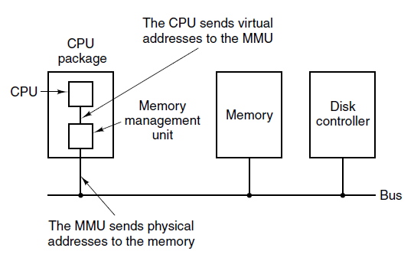
Paging (1)
Figure 3-8. The position and function of the MMU. Here the
MMU is shown as being a part of the CPU chip because
it commonly is nowadays. However, logically it
could be a separate chip and was years ago.

Slide 20
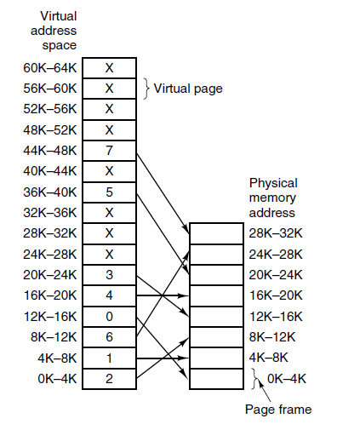
Paging (2)
MOV REG, 0 (MMU receive)
Virtual page 0 (0K-4K)
Page frame 2 (8K-12K)
MOV REG, 8192 (MMU transmit)
MOV REG, 32780 (MMU receive)
Virtual page 8 (32K-36K)
Page frame X
Page fault and OS starts operation
Figure 3-9. The relation between virtual addresses and physical memory addresses is given by the page table. Every page begins on a multiple of 4096 and ends 4095 addresses higher, so 4K–8K really means 4096–8191 and 8K to 12K means 8192–12287

Slide 21
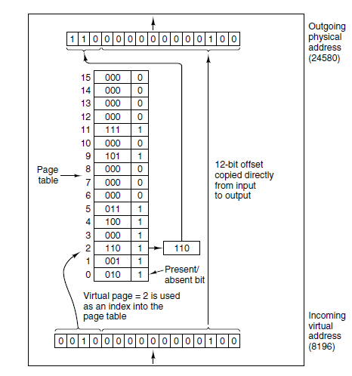
Paging (3)
Figure 3-10. The internal
operation of the MMU
with 16 4-KB pages.

Slide 22
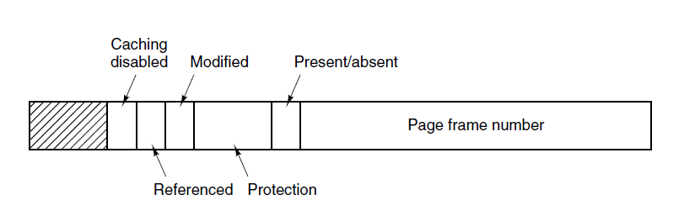
Structure of a Page Table Entry
Figure 3-11. A typical page table entry.

Slide 23
Speeding Up Paging
Major issues faced:
The mapping from virtual address to physical address must be fast.
If the virtual address space is large, the page table will be large.

Slide 24
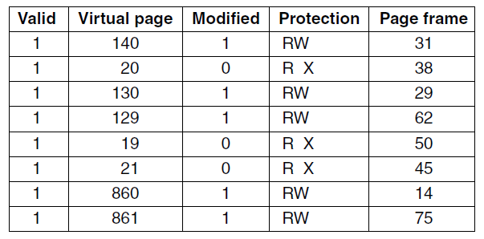
Translation Lookaside Buffers
Figure 3-12. A TLB to speed up paging.

Slide 25
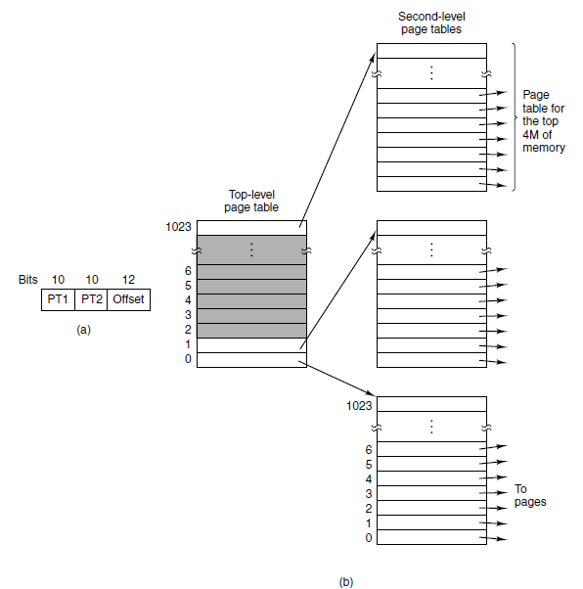
Multilevel Page Tables
Figure 3-13. (a) A 32-bit address with two page table fields. (b) Two-level page tables.

Slide 26
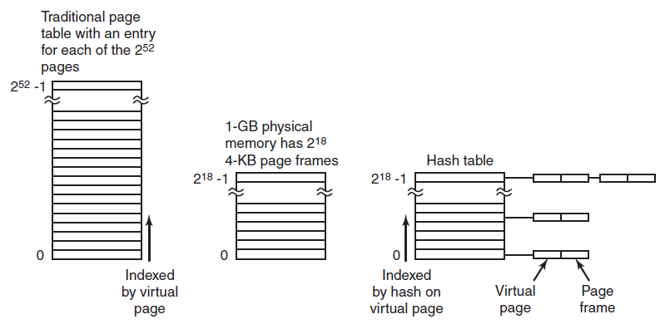
Inverted Page Tables
Figure 3-14. Comparison of a traditional page table
with an inverted page table.

Slide 27
Page Replacement Algorithms
Optimal algorithm
Not recently used algorithm
First-in, first-out (FIFO) algorithm
Second-chance algorithm
Clock algorithm
Least recently used (LRU) algorithm
Working set algorithm
WSClock algorithm

Slide 28
Not Recently Used Algorithm
At page fault, system inspects pages
Categories of pages based on the current values of their R and M bits:
Class 0: not referenced, not modified.
Class 1: not referenced, modified.
Class 2: referenced, not modified.
Class 3: referenced, modified.

Slide 29
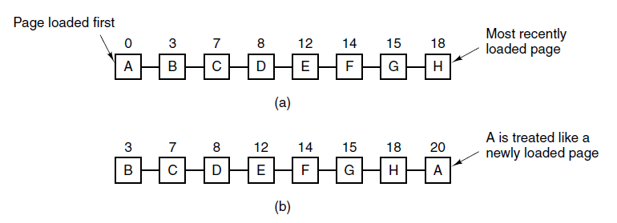
Second-Chance Algorithm
Figure 3-15. Operation of second chance. (a) Pages sorted in FIFO order. (b) Page list if a page fault occurs at time 20 and A has its R bit set. The numbers above the pages are their load times.

Slide 30
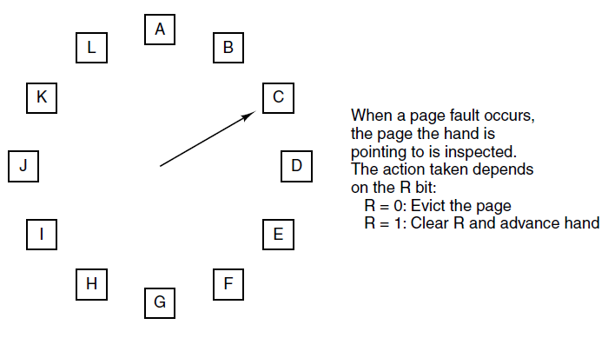
Clock Page Replacement Algorithm
Figure 3-16. The clock page replacement algorithm.

Slide 31
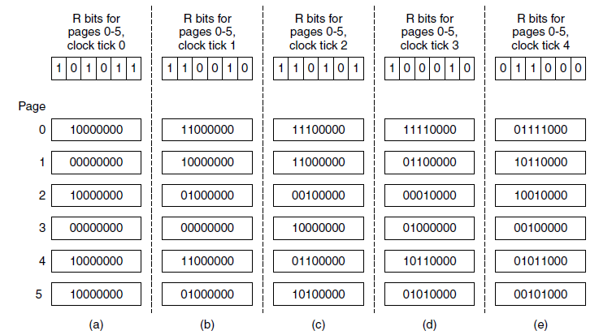
Simulating LRU in Software
Figure 3-17. The aging algorithm simulates LRU in software. Shown are six pages for five clock ticks. The five clock ticks are represented by (a) to (e).

Slide 32
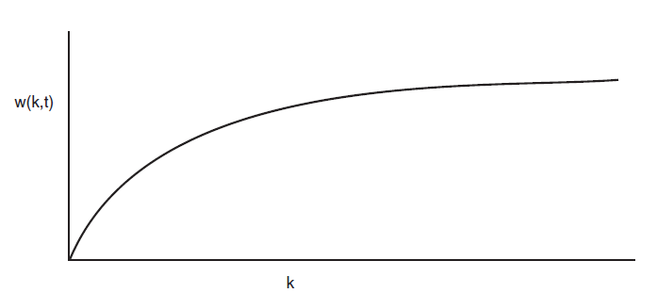
Working Set Algorithm (1)
Figure 3-18. The working set is the set of pages used by the k most recent memory references. The function w(k, t) is the size of the working set at time t.

Slide 33
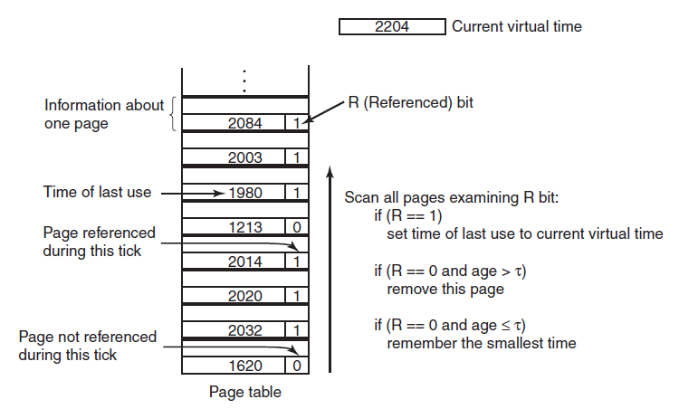
Working Set Algorithm (2)
Figure 3-19. The working set algorithm.

Slide 34
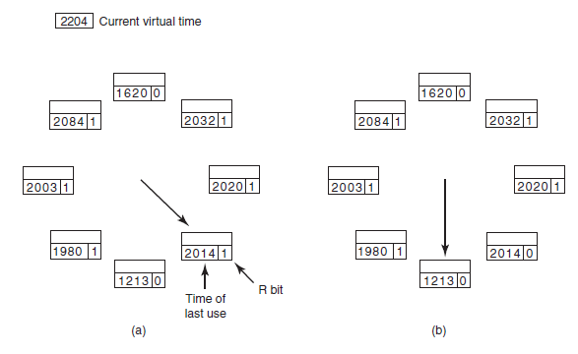
WSClock Algorithm (1)
Figure 3-20. Operation of the WSClock algorithm. (a) and (b) give an example of what happens when R = 1.

Slide 35
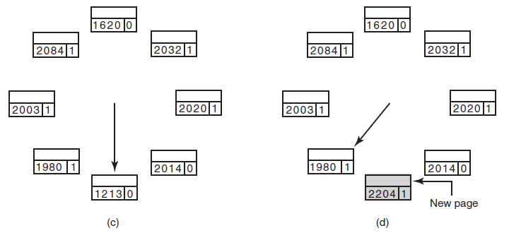
WSClock Algorithm (2)
Figure 3-20. Operation of the WSClock algorithm.
(c) and (d) give an example of R = 0.

Slide 36
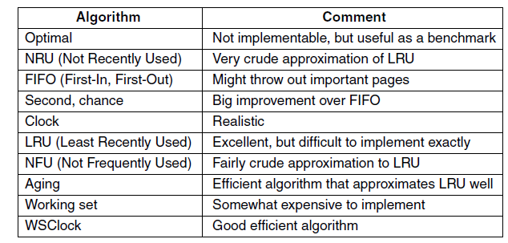
Summary of Page Replacement Algorithms
Figure 3-21. Page replacement algorithms discussed in the text.

Slide 37
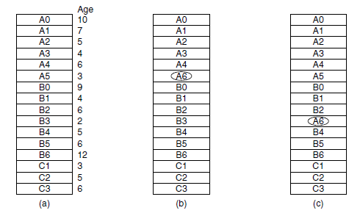
Local versus Global Allocation Policies (1)
Figure 3-22. Local versus global page replacement.
(a) Original configuration. (b) Local page replacement.
(c) Global page replacement.

Slide 38
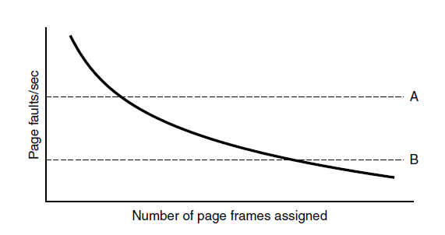
Local versus Global Allocation Policies (2)
Figure 3-23. Page fault rate as a function of the number of page frames assigned.

Slide 39
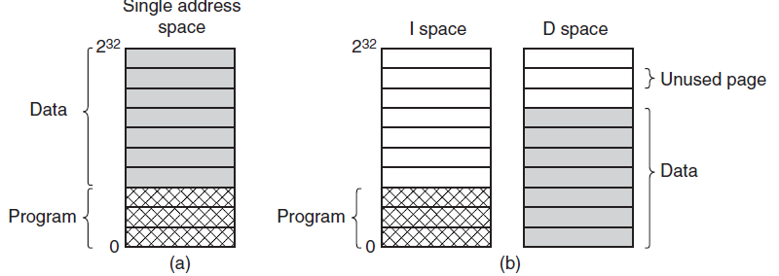
Separate Instruction and Data Spaces
Figure 3-24. (a) One address space.
(b) Separate I and D spaces.

Slide 40
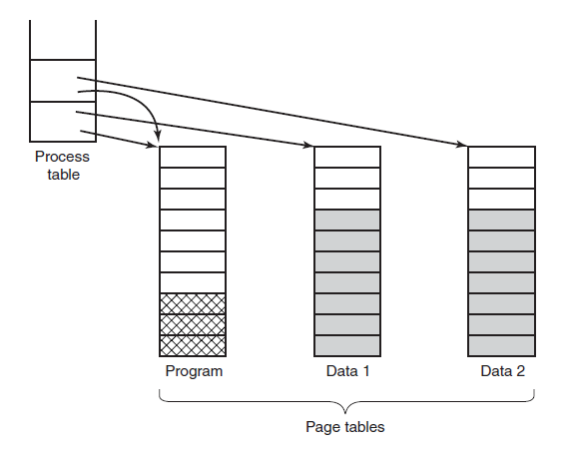
Shared Pages
Figure 3-25. Two processes sharing the same
program sharing its page table.

Slide 41
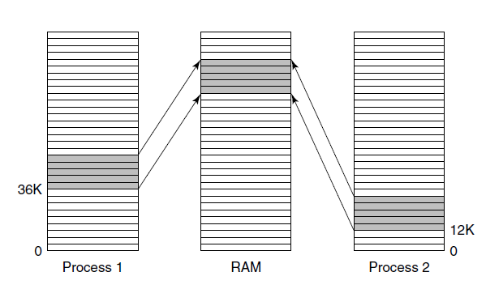
Shared Libraries
Figure 3-26. A shared library being used by two processes.

Slide 42
Page Fault Handling (1)
The hardware traps to kernel, saving program counter on stack.
Assembly code routine started to save general registers and other volatile info
system discovers page fault has occurred, tries to discover which virtual page needed
Once virtual address caused fault is known, system checks to see if address valid and the protection consistent with access

Slide 43
Page Fault Handling (2)
If frame selected dirty, page is scheduled for transfer to disk, context switch takes place, suspending faulting process
As soon as frame clean, operating system looks up disk address where needed page is, schedules disk operation to bring it in.
When disk interrupt indicates page has arrived, tables updated to reflect position, and frame marked as being in normal state.

Slide 44
Page Fault Handling (3)
Faulting instruction backed up to state it had when it began and program counter is reset
Faulting process is scheduled, operating system returns to routine that called it.
Routine reloads registers and other state information, returns to user space to continue execution

Slide 45
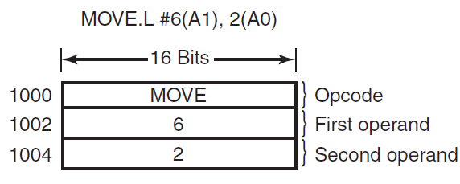
Instruction Backup
Figure 3-27. An instruction causing a page fault.

Slide 46
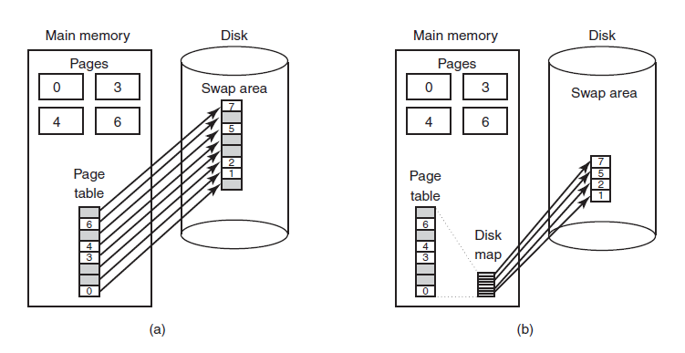
Backing Store
Figure 3-28. (a) Paging to a static swap area.
(b) Backing up pages dynamically.

Slide 47
Separation of Policy and Mechanism (1)
Memory management system is divided into three parts
A low-level MMU handler.
A page fault handler that is part of the kernel.
An external pager running in user space.

Slide 48
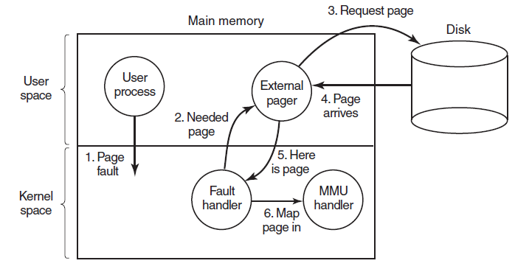
Separation of Policy and Mechanism (2)
Figure 3-29. Page fault handling with an external pager.

Slide 49
Segmentation (1)
Examples of tables generated by compiler:
The source text being saved for the printed listing
The symbol table, names and attributes of variables.
The table containing integer and floating-point constants used.
The parse tree, syntactic analysis of the program.
The stack used for procedure calls within compiler.

Slide 50
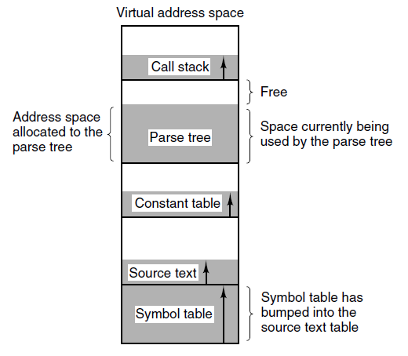
Segmentation (2)
Figure 3-30. In a one-dimensional address space with growing tables, one table may bump into another.

Slide 51
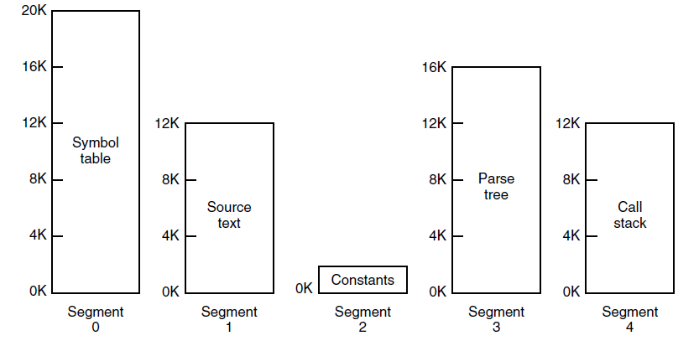
Segmentation (3)
Figure 3-31. A segmented memory allows each table to grow or shrink independently of the other tables.

Slide 52
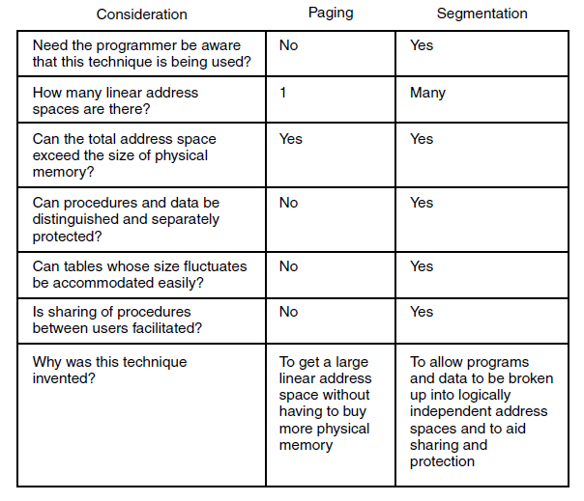
Segmentation (4)
Figure 3-32. Comparison of paging and segmentation

Slide 53
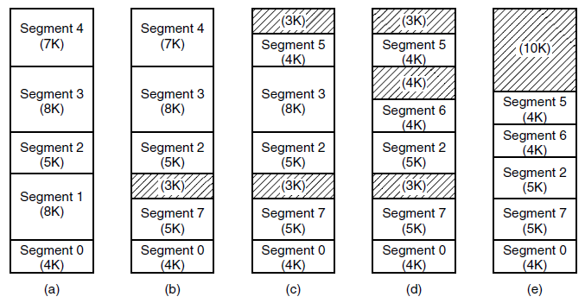
Implementation of Pure Segmentation
Figure 3-33. (a)-(d) Development of checkerboarding.
(e) Removal of the checkerboarding by compaction.

Slide 54
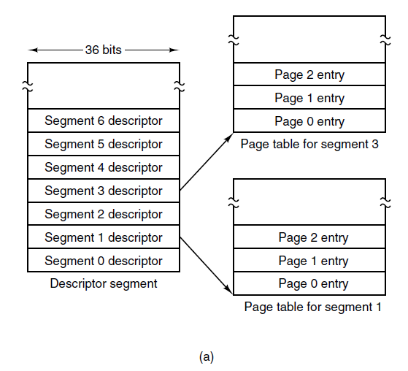
Segmentation with Paging: MULTICS (1)
Figure 3-34. The MULTICS virtual memory. (a) The descriptor segment pointed to the page tables.

Slide 55
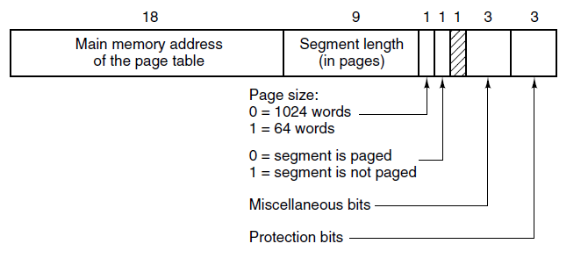
Segmentation with Paging: MULTICS (2)
Figure 3-34. The MULTICS virtual memory. (b) A segment descriptor. The numbers are the field lengths.

Slide 56
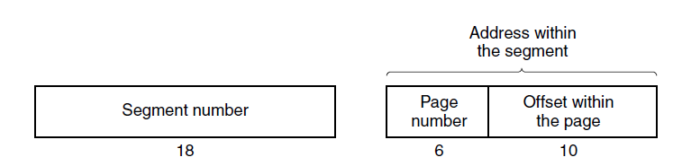
Segmentation with Paging: MULTICS (3)
Figure 3-35. A 34-bit MULTICS virtual address.

Slide 57
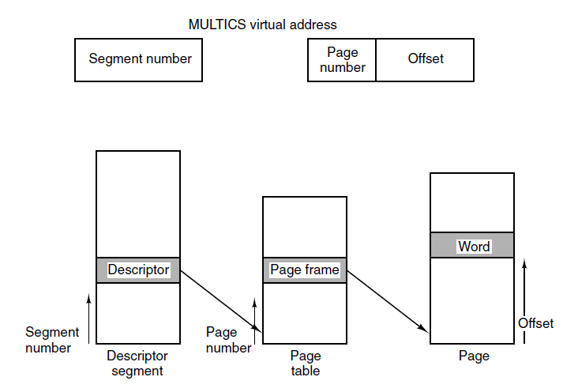
Segmentation with Paging: MULTICS (4)
Figure 3-36. Conversion of a two-part MULTICS address into a main memory address.

Slide 58
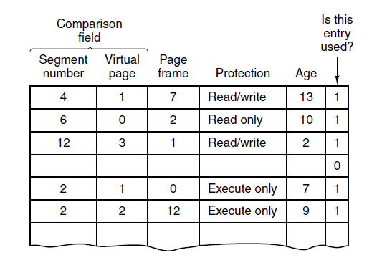
Segmentation with Paging: MULTICS (5)
Figure 3-37. A simplified version of the MULTICS TLB. The existence of two page sizes made the actual TLB more complicated.

Slide 59
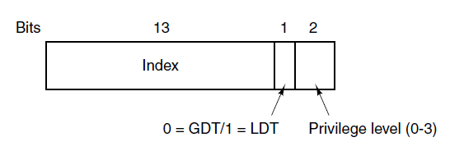
Segmentation with Paging:
The Intel x86 (1)
Figure 3-38. An x86 selector.

Slide 60
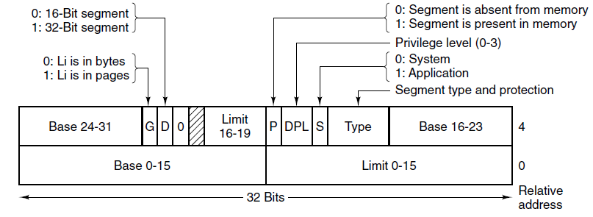
Segmentation with Paging:
The Intel x86 (2)
Figure 3-39. x86 code segment descriptor.
Data segments differ slightly.

Slide 61
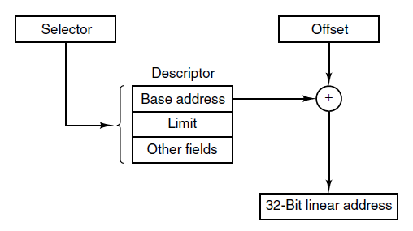
Segmentation with Paging:
The Intel x86 (3)
Figure 3-40. Conversion of a (selector, offset)
pair to a linear address.

Slide 62
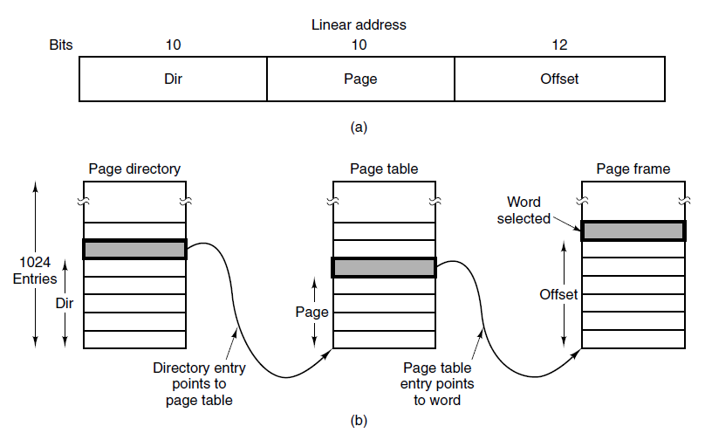
Segmentation with Paging:
The Intel x86 (4)
Figure 3-41. Mapping of a linear address
onto a physical address.

Slide 63
End
Chapter 3

